Slide 1


Workshop Introducing SQL: A Foundation of Data Analytics
Robb Sombach
University of Alberta
Alberta School of Business

Slide 2
Agenda
Introduction
Why SQL?
What about Python? R?
Data Analytics
Relational Database
What is a database?
Terminology
SQLite
Exercise 1
SQL
Data Definition Language (DDL)
Exercise 2
Data Manipulation Language (DML)
Exercise 3
Open Data Portal
How I prepared for today

Slide 3
Robb Sombach
Work Experience
15+ years working in the IT industry
10+ years Self-Employed IT Consultant
IT Positions
Systems Analyst / Business Analyst
Database Administrator (Oracle / SQL Server)
Network Administrator
Developer

Slide 4
Robb Sombach
Teaching Experience
5 years teaching at NAIT
Computer Systems Technology (CST)
Digital Media and Information Technology (DMIT)
6+ years teaching at University of Alberta
Technology Training Centre
Alberta School of Business

Slide 5
Resources
All Workshop files can be downloaded here
http://bit.ly/odd_2019

Slide 6
Introduction
Workshop
Introducing SQL: Foundation of Data Analytics

Slide 7
Goals
Introduce relational database concepts
Provides hands-on, real world database experience using data from the City of Edmonton Open Data Portal
Foster a collaborative workshop
Please interupt and ask questions

Slide 8
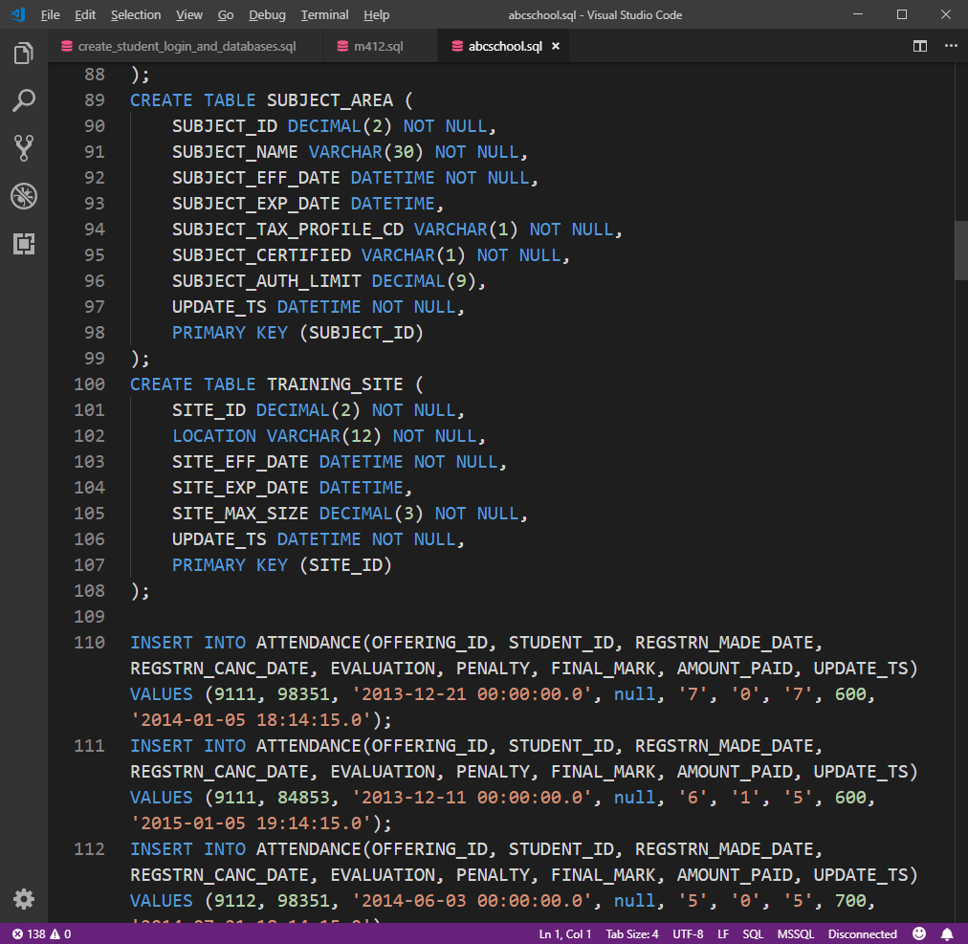
Why SQL?
Simple
Accessible
Applicable
Powerful
Pervasive
Valuable
Universal

Slide 9
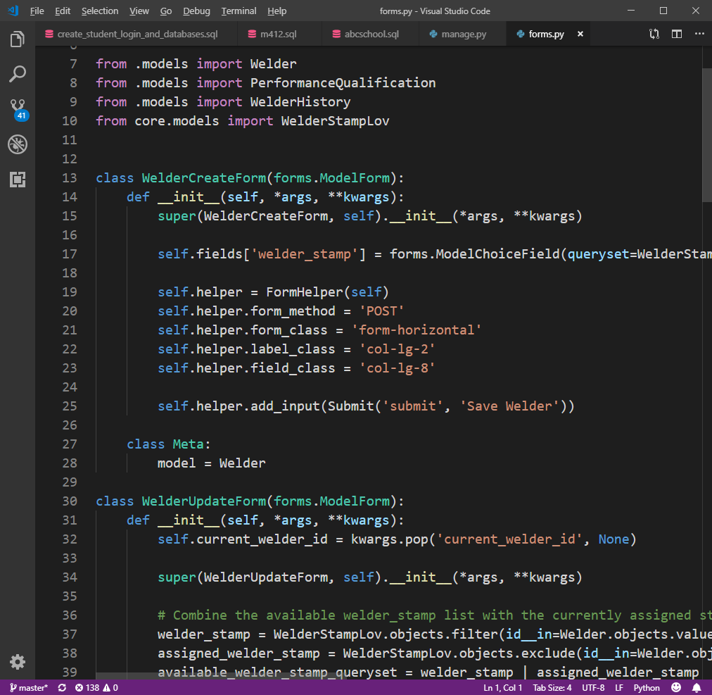
Why not Python? R?
Difficult for beginners
Complicated syntax
Requires programming knowledge (logic, algorithms)
Is SQL better than Python or R?
SQL is good for some things
Python/R is good for other things
Compliment each other
SQL is a great starting point

Slide 10
Data Analytics
Analytics is the discovery, interpretation, and communication of meaningful patterns in data; and the process of applying those patterns towards effective decision making
Organizations may apply analytics to business data to describe, predict, and improve business performance
https://en.wikipedia.org/wiki/Analytics
Notes:
https://en.wikipedia.org/wiki/Analytics

Slide 11
Relational Database
Workshop
Introducing SQL: Foundation of Data Analytics

Slide 12
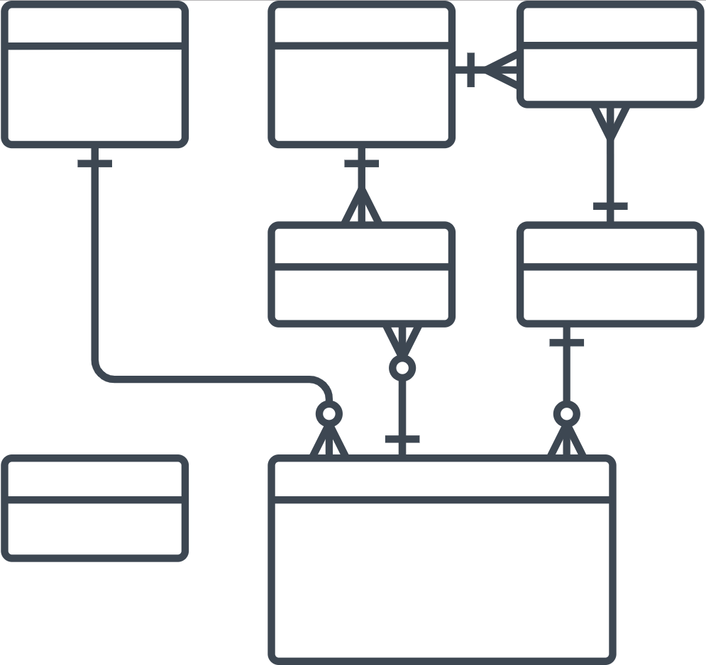
What is a database?
A relational “database” management system (RDBMS) organizes data
The logical structure of the database is based upon the information needs of an organization
Entities (“things” of interest to the organization),
AND
Relationships (how the Entities are associated with each other)

Slide 13
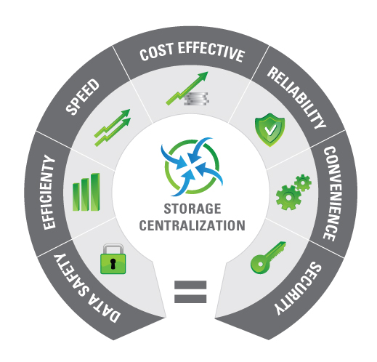
Advantages of a RDBMS
Establish a centralized, logical view of data
Minimizes data duplication (i.e. “redundancy”)
Promote data accuracy and integrity
Capacity of database
Superior multi-user or concurrent access
Security
Retrieve information quickly
Inter-operability
https://www.bespokesoftwaredevelopment.com/blog/advantages-database-development-business/

Slide 14

Database Terminology
Table, Entity, Relation, (similar to an Excel Worksheet)
Row, Record, Instance
Column, Field, Attribute
Primary Key – unique and mandatory
Foreign Key – a cross-reference between tables because it references the primary key of another table
Relationship – created though foreign keys

Slide 15

How to introduce SQL?
Microsoft Access
https://products.office.com/en-ca/access
Microsoft SQL Server
https://www.microsoft.com/en-us/sql-server/sql-server-2017
MariaDB, MySQL
https://mariadb.org/
https://www.mysql.com/
Postgresql
https://www.postgresql.org/
Oracle
https://www.oracle.com/database/
Hadoop, Spark, Hive, Pig
https://hadoop.apache.org/

Slide 16
A database that …
Has full-featured SQL
Has billions and billions of deployments
Is a single-file database
Has public domain source code
Small footprint
Has a max DB size of 140 terabytes
Has a max row size of 1 gigabyte
Is faster than direct file access
Aviation-grade quality and testing
Zero-configuration
Has ACID (Atomic, Consistent, Isolated, and Durable) transactions, even after power loss
Has a stable, enduring file format
Is has extensive, detailed documentation
Has long-term support (to the year 2050)
https://www.sqlite.org/about.html

Slide 17
SQLite
“SQLite is the most widely deployed database in the world with more applications than we can count, including several high-profile projects”
https://www.sqlite.org/famous.html
“SQLite is an in-process library that implements a self-contained, serverless, zero-configuration, transactional SQL database engine”
https://www.sqlite.org/about.html
Perfect for learning SQL (the foundation of data analytics)

Slide 18
Exercise 1: Download and Run SQLite BD Browser
Download SQLite
Download SQLite DB Browser Portable
https://sqlitebrowser.org/dl/

Slide 19
Exercise 1: Download and Run SQLite
Extract the ZIP archive to the Desktop
Start SQLite
SQLiteDatabaseBrowserPortable.exe
Create a New database
open_data_day_2019.db
Save the database in the Data folder
Click Cancel when prompted to create a table
Done!

Slide 20
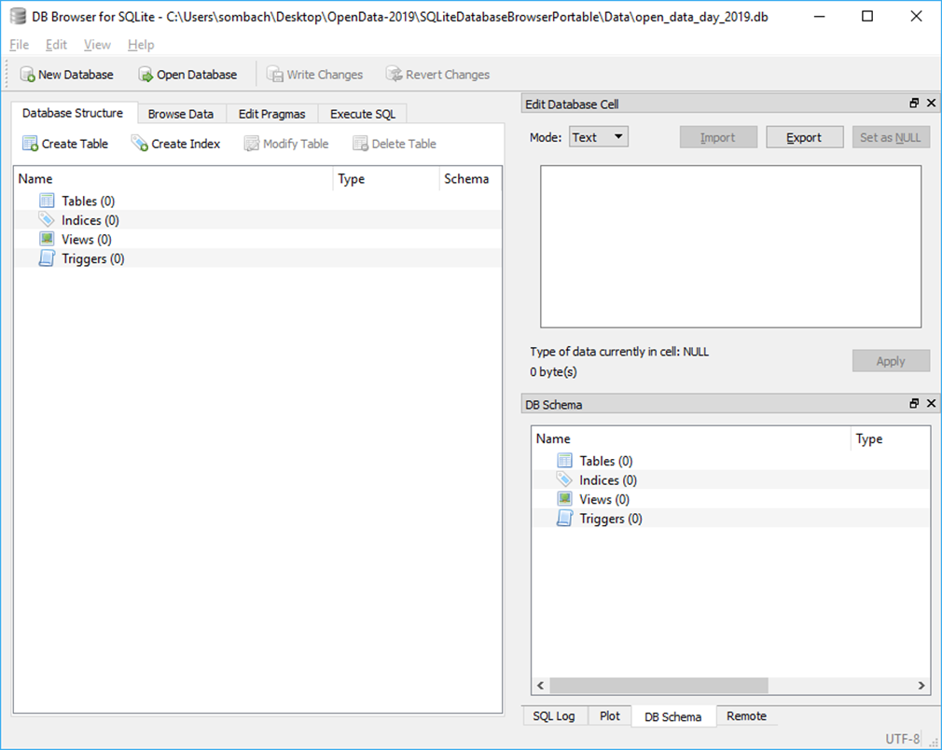
Exercise 1: Completed
Notes:
https://www.w3schools.com/sql/

Slide 21
SQL
Workshop
Introducing SQL: Foundation of Data Analytics

Slide 22
What is SQL?
SQL stands for Structured Query Language
SQL is pronounced S-Q-L or sequel
SQL is a standard language for managing, manipulating and querying databases
Developed at IBM in the early 1970’s
In 1986, ANSI and ISO standard groups officially adopted the standard “Database Language SQL” definition
Most SQL databases have their own proprietary extensions in addition to the SQL standard
SQL is the language used to ask questions (query) of a database which will return answers (results)
Notes:
https://www.w3schools.com/sql/

Slide 23
Why is SQL the foundation of Data Analytics?
Data engineers and database administrators will use SQL to ensure that everybody in their organization has access to the data they need
Data scientists will use SQL to load data into their models
Data analysts will use SQL to query tables of data and derive insights from it

Slide 24
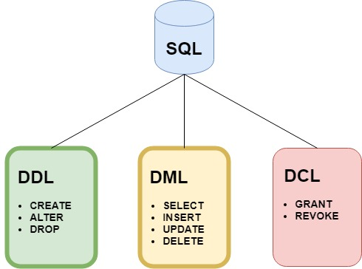
Components of SQL
SQL consists of three components which offer everything required to manage, maintain and use a database
Data Definition Language
Data Manipulation Language
Data Control Language

Slide 25
Data Definition Language (DDL)
This component is used to define the structure (or schema) of the database
For tables there are three main commands:
CREATE TABLE table_name
To create a table in the database
ALTER TABLE table_name
To add or remove columns from a table in the database
DROP TABLE table_name
To remove a table from the database

Slide 26

Exercise 2: Data Definition Language
Select the Execute SQL tab in SQLite
Type or copy/paste the CREATE TABLE statement into the empty SQLite Execute SQL window
Click the Execute SQL button on the toolbar
If the table is created successfully, you should receive the following message:
Query executed successfully: CREATE TABLE "MOSQUITO_TRAP_DATA“
Click Write Changes to make commit the changes permanent
View the changes in the Database Structure tab

Slide 27
CREATE TABLE "MOSQUITO_TRAP_DATA" (
`SAMPLEID` INTEGER PRIMARY KEY AUTOINCREMENT,
`TRAP_DATE` NUMERIC,
`GENUS` TEXT,
`SPECIES` TEXT,
`TYPE` TEXT,
`GENDER` TEXT
);
https://www.sqlite.org/lang_createtable.html

Slide 28
Exercise 2: Data Definition Language
Select the Execute SQL tab in SQLite
Type or copy/paste the ALTER TABLE statements into the empty SQLite Execute SQL window
Click the Execute SQL button on the toolbar
If the table is created successfully, you should receive the following message:
Query executed successfully: ALTER TABLE "MOSQUITO_TRAP_DATA“
Click Write Changes to make commit the changes permanent
View the changes in the Database Structure tab

Slide 29
ALTER TABLE "MOSQUITO_TRAP_DATA" ADD COLUMN `RURALNORTHWEST` INTEGER;
ALTER TABLE "MOSQUITO_TRAP_DATA" ADD COLUMN `RURALNORTHEAST` INTEGER;
ALTER TABLE "MOSQUITO_TRAP_DATA" ADD COLUMN `RURALSOUTHEAST` INTEGER;
ALTER TABLE "MOSQUITO_TRAP_DATA" ADD COLUMN `RIVERVALLEYEAST` INTEGER;
ALTER TABLE "MOSQUITO_TRAP_DATA" ADD COLUMN `RIVERVALLEYWEST` INTEGER;
ALTER TABLE "MOSQUITO_TRAP_DATA" ADD COLUMN `RESIDENTIALNORTH` INTEGER;
ALTER TABLE "MOSQUITO_TRAP_DATA" ADD COLUMN `RURALSOUTHWEST` INTEGER;
ALTER TABLE "MOSQUITO_TRAP_DATA" ADD COLUMN `LAGOON` INTEGER;
ALTER TABLE "MOSQUITO_TRAP_DATA" ADD COLUMN `GOLFCOURSE` INTEGER;
ALTER TABLE "MOSQUITO_TRAP_DATA" ADD COLUMN `INDUSTRIALPARK` INTEGER;
ALTER TABLE "MOSQUITO_TRAP_DATA" ADD COLUMN `RESIDENTIALSOUTH` INTEGER;
ALTER TABLE "MOSQUITO_TRAP_DATA" ADD COLUMN `TOTAL` INTEGER;
https://www.sqlite.org/lang_altertable.html

Slide 30
Exercise 2: Data Definition Language
Select the Execute SQL tab in SQLite
Type or copy/paste the DROP TABLE statement into the empty SQLite Execute SQL window
Click the Execute SQL button on the toolbar
If the table is created successfully, you should receive the following message:
Query executed successfully: DROP TABLE "MOSQUITO_TRAP_DATA"
Click Write Changes to make commit the changes permanent
View the changes in the Database Structure tab

Slide 31
DROP TABLE "MOSQUITO_TRAP_DATA";
https://www.sqlite.org/lang_droptable.html

Slide 32
Exercise 2: Data Definition Language
Create the MOSQUITO_TRAP_DATA table again using the DDL on the next slide
Click Write Changes to make commit the changes permanent
View the changes in the Database Structure tab
Done!

Slide 33
CREATE TABLE "MOSQUITO_TRAP_DATA" (
`SAMPLEID` INTEGER PRIMARY KEY AUTOINCREMENT,
`TRAP_DATE` NUMERIC,
`GENUS` TEXT,
`SPECIES` TEXT,
`TYPE` TEXT,
`GENDER` TEXT,
`RURALNORTHWEST` INTEGER,
`RURALNORTHEAST` INTEGER,
`RURALSOUTHEAST` INTEGER,
`RIVERVALLEYEAST` INTEGER,
`RIVERVALLEYWEST` INTEGER,
`RESIDENTIALNORTH` INTEGER,
`RURALSOUTHWEST` INTEGER,
`LAGOON` INTEGER,
`GOLFCOURSE` INTEGER,
`INDUSTRIALPARK` INTEGER,
`RESIDENTIALSOUTH` INTEGER,
`TOTAL` INTEGER
)
https://www.sqlite.org/lang_createtable.html

Slide 34
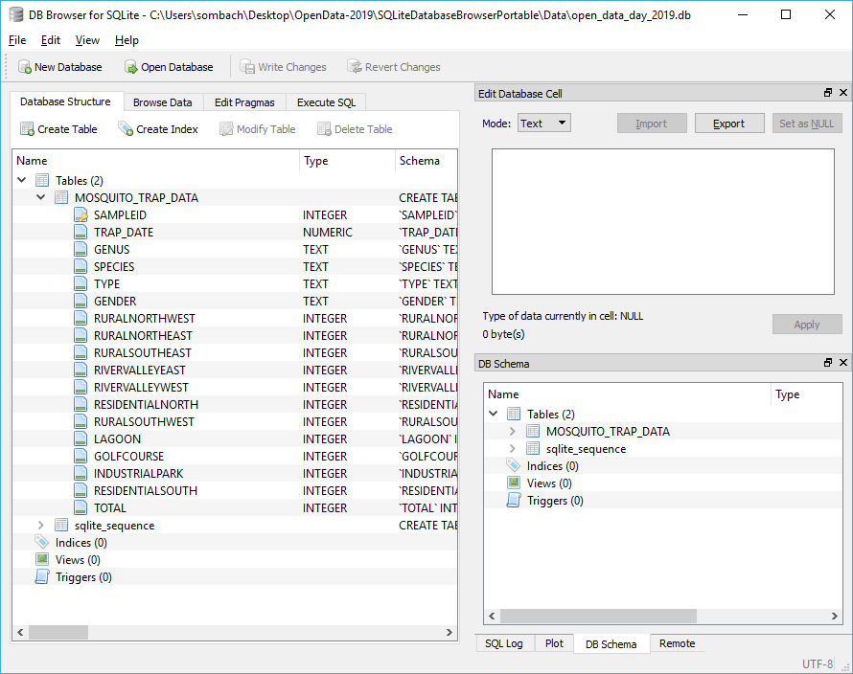
Exercise 1: Completed
Notes:
https://www.w3schools.com/sql/

Slide 35
Data Manipulation Language
This component is used to manipulate data within a table
There are four main commands:
SELECT
To select rows of data from a table
INSERT
To insert rows of data into a table
UPDATE
To change rows of data in a table
DELETE
To remove rows of data from a table

Slide 36
Exercise 3: SELECT Data Manipulation Language
Select the Execute SQL tab in SQLite
Type or copy/paste the SELECT statement into the empty SQLite Execute SQL window
SELECT COUNT(*) FROM MOSQUITO_TRAP_DATA;
Click the Execute SQL button on the toolbar
Do you get an answer? Why not?
https://www.sqlite.org/lang_select.html

Slide 37
Exercise 3: INSERT Data Manipulation Language
Add some data to the MOSQUITO_TRAP_DATA table created in Exercise 2
Type or copy/paste the INSERT statement into the empty SQLite Execute SQL window
Click the Execute SQL button on the toolbar
Click Write Changes to make commit the changes permanent
View the changes in the Browse Data tab
The MOSQUITO_TRAP_DATA table now has seven rows of data

Slide 38
INSERT INTO "MOSQUITO_TRAP_DATA" (TRAP_DATE, GENUS, SPECIES, TYPE, GENDER, RURALNORTHWEST, RURALNORTHEAST, RURALSOUTHEAST, RIVERVALLEYEAST, RIVERVALLEYWEST, RESIDENTIALNORTH, RURALSOUTHWEST, LAGOON, GOLFCOURSE, INDUSTRIALPARK, RESIDENTIALSOUTH, TOTAL) VALUES ('2014-07-01','Aedes','spencerii','Black legs','Female',0,0,0,0,0,1,0,0,0,1,1,3);
INSERT INTO "MOSQUITO_TRAP_DATA" (TRAP_DATE, GENUS, SPECIES, TYPE, GENDER, RURALNORTHWEST, RURALNORTHEAST, RURALSOUTHEAST, RIVERVALLEYEAST, RIVERVALLEYWEST, RESIDENTIALNORTH, RURALSOUTHWEST, LAGOON, GOLFCOURSE, INDUSTRIALPARK, RESIDENTIALSOUTH, TOTAL) VALUES ('2014-07-01','Aedes','dorsalis','Banded legs','Female',0,1,0,0,0,0,2,0,0,0,0,3);
INSERT INTO "MOSQUITO_TRAP_DATA" (TRAP_DATE, GENUS, SPECIES, TYPE, GENDER, RURALNORTHWEST, RURALNORTHEAST, RURALSOUTHEAST, RIVERVALLEYEAST, RIVERVALLEYWEST, RESIDENTIALNORTH, RURALSOUTHWEST, LAGOON, GOLFCOURSE, INDUSTRIALPARK, RESIDENTIALSOUTH, TOTAL) VALUES ('2014-07-01','Aedes','euedes','Banded legs','Female',1,1,0,0,2,0,0,0,0,0,0,4);
INSERT INTO "MOSQUITO_TRAP_DATA" (TRAP_DATE, GENUS, SPECIES, TYPE, GENDER, RURALNORTHWEST, RURALNORTHEAST, RURALSOUTHEAST, RIVERVALLEYEAST, RIVERVALLEYWEST, RESIDENTIALNORTH, RURALSOUTHWEST, LAGOON, GOLFCOURSE, INDUSTRIALPARK, RESIDENTIALSOUTH, TOTAL) VALUES ('2014-07-01','Aedes','excrucians','Banded legs','Female',1,2,0,0,2,1,0,0,0,1,0,7);
INSERT INTO "MOSQUITO_TRAP_DATA" (TRAP_DATE, GENUS, SPECIES, TYPE, GENDER, RURALNORTHWEST, RURALNORTHEAST, RURALSOUTHEAST, RIVERVALLEYEAST, RIVERVALLEYWEST, RESIDENTIALNORTH, RURALSOUTHWEST, LAGOON, GOLFCOURSE, INDUSTRIALPARK, RESIDENTIALSOUTH, TOTAL) VALUES ('2014-07-01','Aedes','fitchii','Banded legs','Female',0,2,0,0,1,0,0,0,0,0,4,7);
INSERT INTO "MOSQUITO_TRAP_DATA" (TRAP_DATE, GENUS, SPECIES, TYPE, GENDER, RURALNORTHWEST, RURALNORTHEAST, RURALSOUTHEAST, RIVERVALLEYEAST, RIVERVALLEYWEST, RESIDENTIALNORTH, RURALSOUTHWEST, LAGOON, GOLFCOURSE, INDUSTRIALPARK, RESIDENTIALSOUTH, TOTAL) VALUES ('2014-07-01','Aedes','flavescens','Banded legs','Female',6,5,8,0,0,0,5,0,0,3,1,28);
INSERT INTO "MOSQUITO_TRAP_DATA" (TRAP_DATE, GENUS, SPECIES, TYPE, GENDER, RURALNORTHWEST, RURALNORTHEAST, RURALSOUTHEAST, RIVERVALLEYEAST, RIVERVALLEYWEST, RESIDENTIALNORTH, RURALSOUTHWEST, LAGOON, GOLFCOURSE, INDUSTRIALPARK, RESIDENTIALSOUTH, TOTAL) VALUES ('2014-07-01','Aedes','vexans','Banded legs','Female',3,168,1,21,38,8,16,0,0,3,32,290);
https://www.sqlite.org/lang_insert.html

Slide 39
Exercise 3: SELECT Data Manipulation Language
Type or copy/paste the SELECT statement into the empty SQLite Execute SQL window
SELECT COUNT(*) FROM MOSQUITO_TRAP_DATA;
Click the Execute SQL button on the toolbar
When you execute the query, you are asking the database a question
Can you tell me the number of rows in the MOSQUITO_TRAP_DATA table?
The database gives you an answer (the result) and you should have received the following message:
7 rows returned in 1ms from: SELECT * FROM MOSQUITO_TRAP_DATA;
https://www.sqlite.org/lang_select.html

Slide 40
Exercise 3: SELECT Data Manipulation Language
What if you want to see all the rows in your database?
SELECT * FROM MOSQUITO_TRAP_DATA;
Returns all columns and rows in a table
What if you only want to see the Genus, Species and Total of each row?
SELECT GENUS, SPECIES, TOTAL FROM MOSQUITO_TRAP_DATA;
Returns only the GENUS, SPECIES, TOTAL columns for each row in a table
https://www.sqlite.org/lang_select.html

Slide 41
Data Manipulation Language
The WHERE clause
Uses operators to extract only those records that fulfill a specified condition
Used to ask more complicated questions
SQL will do exactly what you ask, not always what you expect
“I do not think it means what you think it means”
Inigo Montoya
Operator | Description
= | Equal
<> | Not equal. Note: In some versions of SQL this operator may be written as !=
> | Greater than
< | Less than
>= | Greater than or equal
<= | Less than or equal
BETWEEN | Between a certain range
LIKE | Search for a pattern
IN | To specify multiple possible values for a column
https://www.sqlite.org/lang_select.html

Slide 42
Exercise 3: SELECT Data Manipulation Language
Show the rows that have a mosquito TYPE of “Black legs”
SELECT * FROM MOSQUITO_TRAP_DATA WHERE TYPE = 'Black legs';
YOUR TURN
Write and execute a DML statement to answer the question below:
Which mosquito species’ were caught in the traps placed in the west river valley?
https://www.sqlite.org/lang_select.html

Slide 43
Exercise 3: UPDATE Data Manipulation Language
Select the Execute SQL tab in SQLite
Type or copy/paste the UPDATE statement into an empty SQLite Execute SQL window
Click the Execute SQL button on the toolbar
You should receive the following message:
Query executed successfully: … (took 1ms, 4 rows affected)
https://www.sqlite.org/lang_update.html

Slide 44
UPDATE MOSQUITO_TRAP_DATA
SET GENDER = 'Male‘
WHERE SAMPLEID IN (1,3,5,7);
https://www.sqlite.org/lang_update.html

Slide 45
Data Manipulation Language
The GROUP BY clause
Used in collaboration with the SELECT statement to arrange identical data into groups
The GROUP BY statement is often used with aggregate functions
Function | Description
AVG | Calculates the average of a set of values
COUNT | Counts rows in a specified table or view
MAX | Gets the minimum value in a set of values
MIN | Gets the maximum value in a set of values
SUM | Calculates the sum of values
https://www.sqlite.org/lang_aggfunc.html

Slide 46
Exercise 3: SELECT Data Manipulation Language
YOUR TURN
Write and execute a DML statement to answer the question below:
How many mosquitos of each gender were caught in traps throughout the city?
SELECT GENDER, TOTAL FROM MOSQUITO_TRAP_DATA GROUP BY GENDER;
https://www.sqlite.org/lang_select.html

Slide 47
Exercise 3: DELETE Data Manipulation Language
Select the Execute SQL tab in SQLite
Type or copy/paste the DELETE statement into an empty SQLite Execute SQL window
Click the Execute SQL button on the toolbar
You should receive the following message:
Query executed successfully: … (took 0ms, 4 rows affected)
https://www.sqlite.org/lang_update.html

Slide 48
DELETE FROM MOSQUITO_TRAP_DATA WHERE GENDER = "Male";
https://www.sqlite.org/lang_delete.html

Slide 49
Exercise 3: SELECT Data Manipulation Language
YOUR TURN
Write and execute a DML statement to answer the question below:
At which traps were more mosquitos caught? Rural north east or rural north west?
Done!
SELECT SUM(RURALNORTHWEST) AS 'RURAL_WEST', SUM(RURALNORTHEAST) AS 'RURAL_EAST' FROM MOSQUITO_TRAP_DATA;
https://www.sqlite.org/lang_select.html

Slide 50
Advanced SQL
The MOSQUITO database only has one table
Databases with more than one table require tables to be joined
Foreign keys create relationships between tables and must be joined in a DML statement

Slide 51
Download the LED Streetlight Conversion database called odd_streetlight.db
Execute the query below
SELECT LED_STREETLIGHT.STREETLIGHT_ID, LED_STREETLIGHT.TYPE, LOCATION.LOCATION
FROM LED_STREETLIGHT, LOCATION
WHERE LED_STREETLIGHT.STREETLIGHT_ID = LOCATION.STREETLIGHT_ID
AND LED_STREETLIGHT.STREETLIGHT_ID = 12;
https://www.sqlite.org/lang_select.html

Slide 52
City of Edmonton Open Data Portal
Workshop
Introducing SQL: Foundation of Data Analytics

Slide 53
Using the Open Data Portal
https://data.edmonton.ca/
Data sets are usually available in comma separated value (CSV) format
To use the dataset requires cleaning, importing, exploring and understand the data set
Workshop: Exploring & Cleaning Data with OpenRefine
Requires work

Slide 54
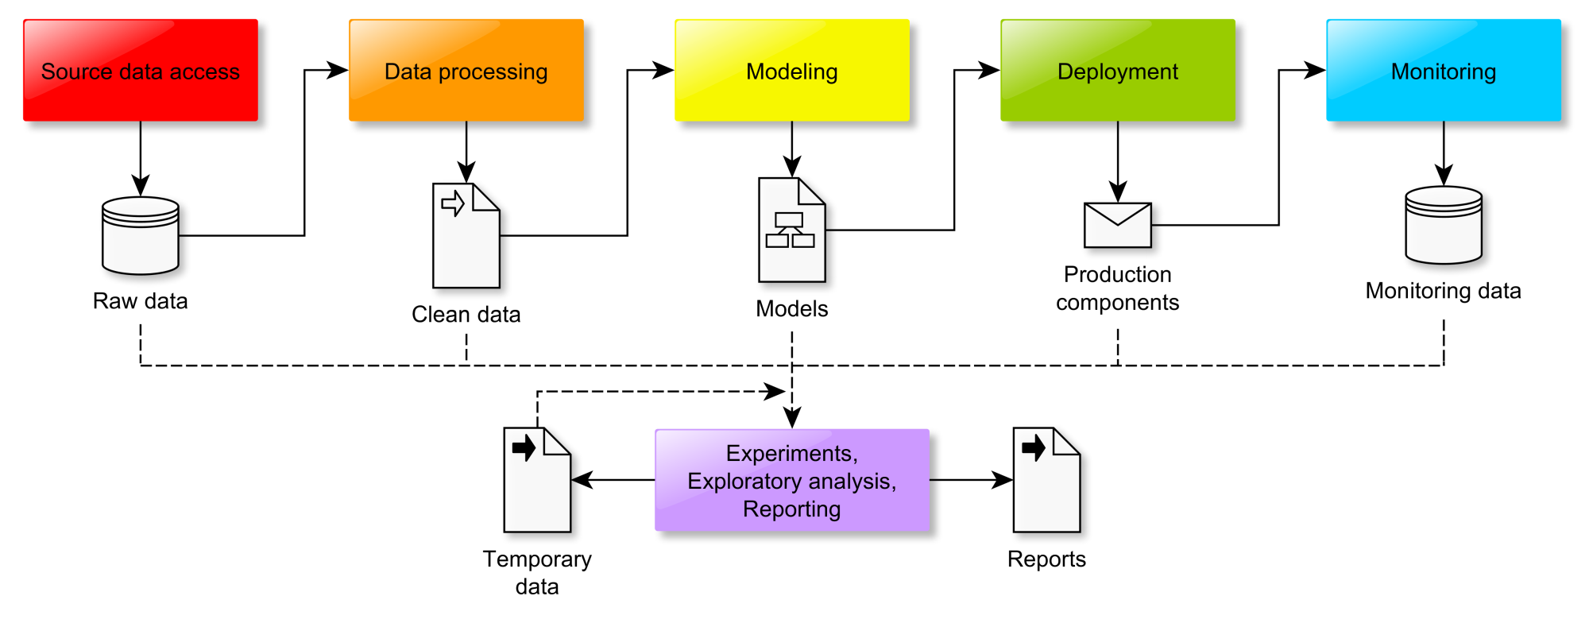
Data Work Flow
http://fouryears.eu/wp-content/uploads/2018/11/pipeline.png

Slide 55
How I prepared the data sets for today
Selected data sets from the Open Data Portal
Downloaded the CSV and surveyed in Google Sheets
Cleaned the data set
E.g. reformatted dates from MMM DD YYYY to YYYY-MM-DD
Imported into directly into SQLite tables
Added primary keys
Explored data set using DML

Slide 56
Some “Mosquitoes Trap Data” questions
How many mosquitos caught in 2014?
SELECT strftime('%Y', TRAP_DATE) as YEAR, SUM(TOTAL)
FROM MOSQUITO_TRAP_DATA
WHERE TOTAL <> ''
AND TOTAL > 0
GROUP BY YEAR;
How many mosquitos of each species were caught?
Which traps caught the most mosquitos?
https://www.sqlite.org/lang_datefunc.html

Slide 57
Some “LED Streetlight Conversion” questions
How many total streetlights?
How many streetlights are converted to LED?
How many streetlights were converted by year?
SELECT strftime('%Y', STARTDATE) as YEAR, TYPE, COUNT(STREETLIGHT_ID)
FROM LED_STREETLIGHT
WHERE TYPE = "LED"
GROUP BY YEAR;
https://www.sqlite.org/lang_datefunc.html

Slide 58
SQL and Climate Change
Connecting and linking various data sets
Builds an understanding of what that data means
Data is a universal language, climate change is a global problem

Slide 59
Next steps
Playing with data and SQL forces you to think and understand the data (builds knowledge)
The relationships between data
The meaning of those relationships
The validity of the data
SQL is iterative, often a “trial and error” process
Don’t be afraid to make mistakes
Team sport – discuss, share, question, collaborate
Data is everywhere which raises questions of privacy, security and ethics

Slide 60

Experiment
https://www.manchester.ac.uk/discover/news/major-leap-towards-storing-data-at-the-molecular-level/

Slide 61
If there’s time … (I talked too fast)
Let’s (democratically):
Choose a dataset not discussed during the workshops
Formulate a question related to the dataset
Load the data into SQLite
Execute some DML to answer the question

Slide 62

Thank you!
Robb Sombach
sombach@ualberta.ca
robb@sombach.com
LinkedIn

Slide 63
References
https://opendataday.org/
https://data36.com/sql-for-data-analysis-tutorial-beginners/
https://www.datascience.com/blog/to-sql-or-not-to-sql-that-is-the-question
https://codebeautify.org/sqlformatter

